Slide 1
INSTRUCTIOn - trivi system -

Slide 2
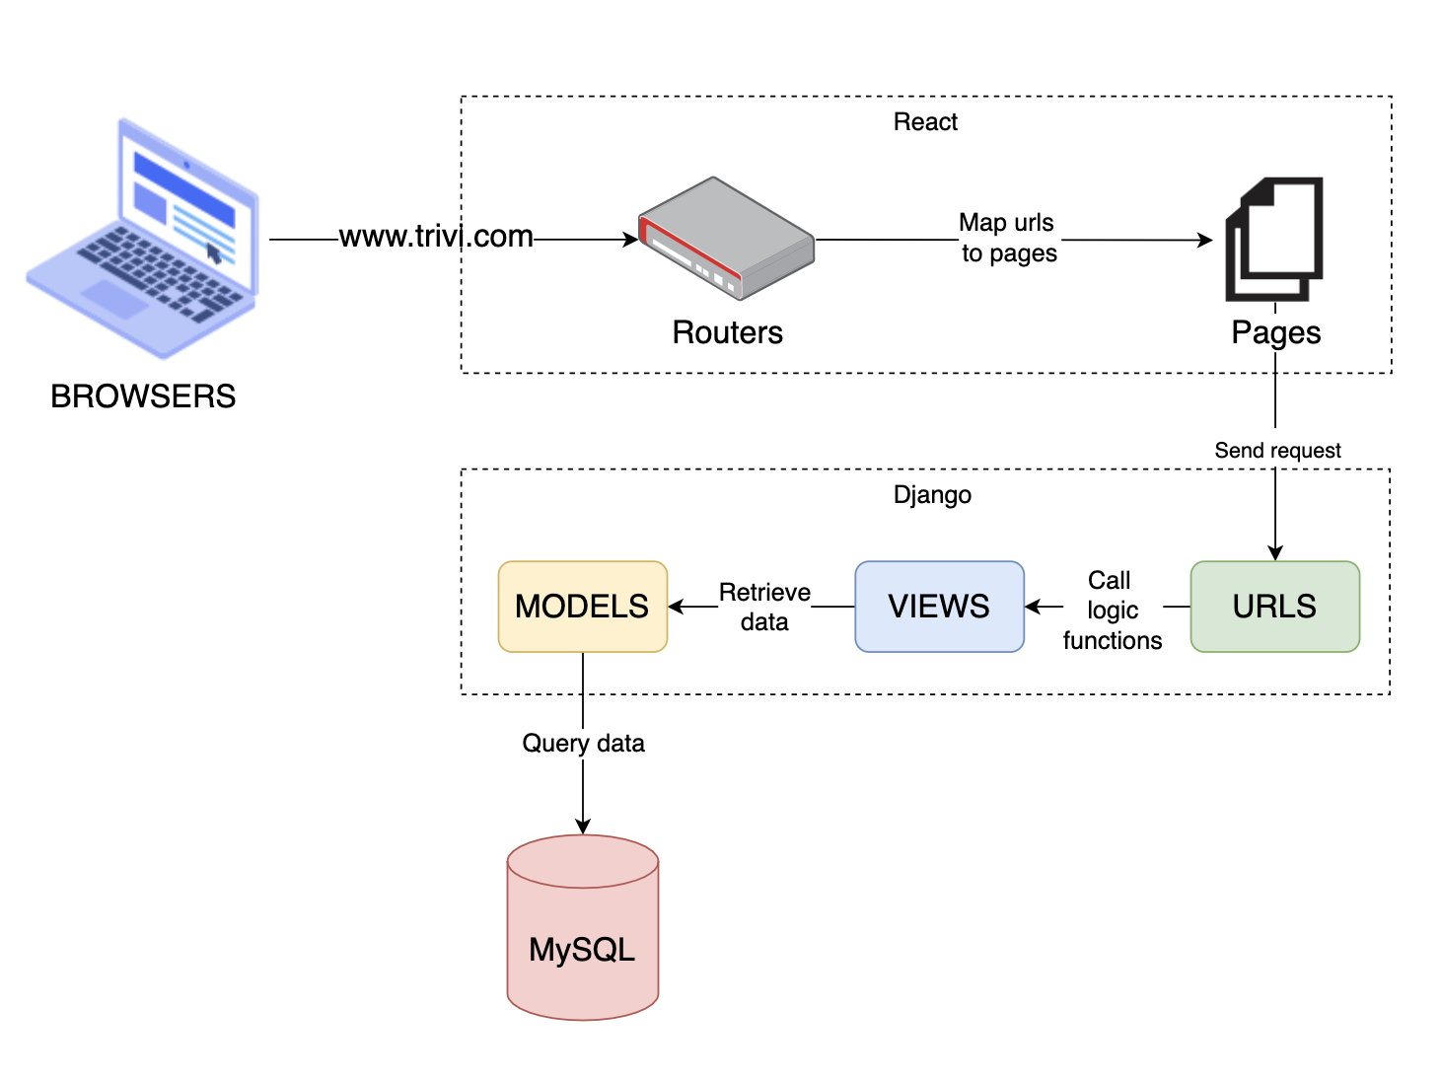
Overview architecture

Slide 3
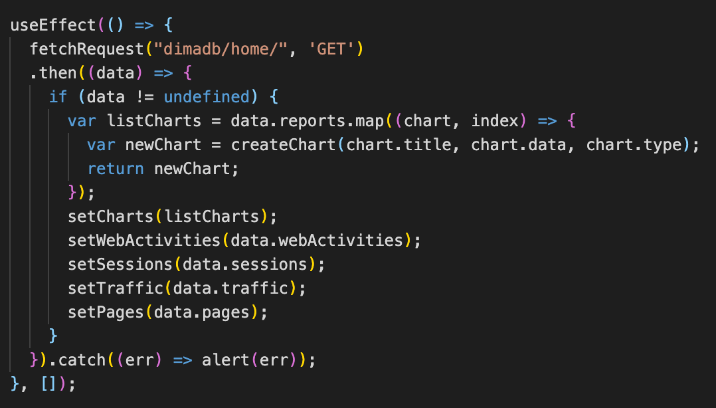
FRONT-END/PAGES
For each Page File:
The useEffect() is called firstly before a page is rendered.
The fetchRequest() function is responsible for sending the request to the Backend.

Slide 4
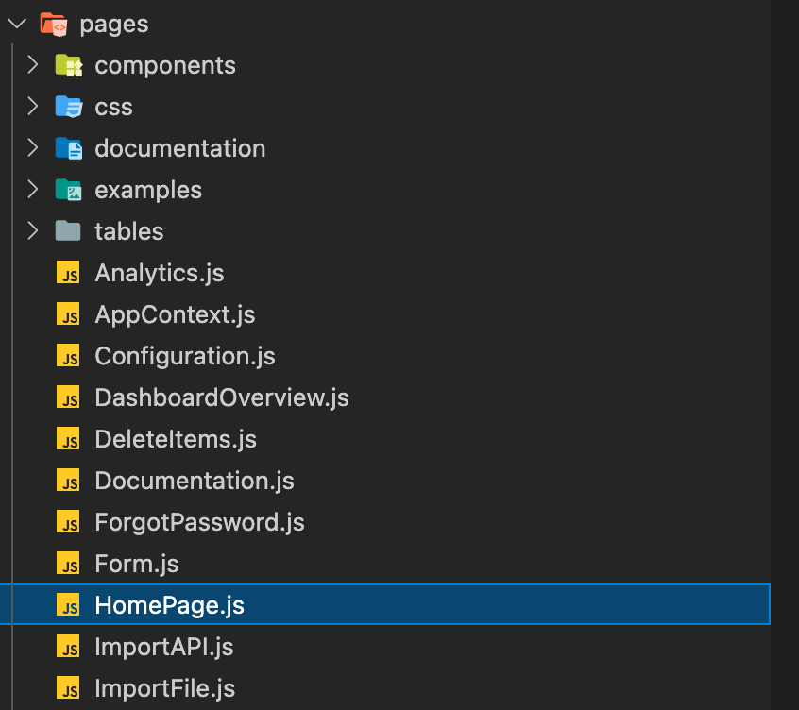
FRONT-END/PAGES
Folder trivi-react/src/pages :
Folder includes a list of files, each of which will contain source code to render to a corresponding page (For example, File Dashboard.js will display the Dashboard page on the website)

Slide 5
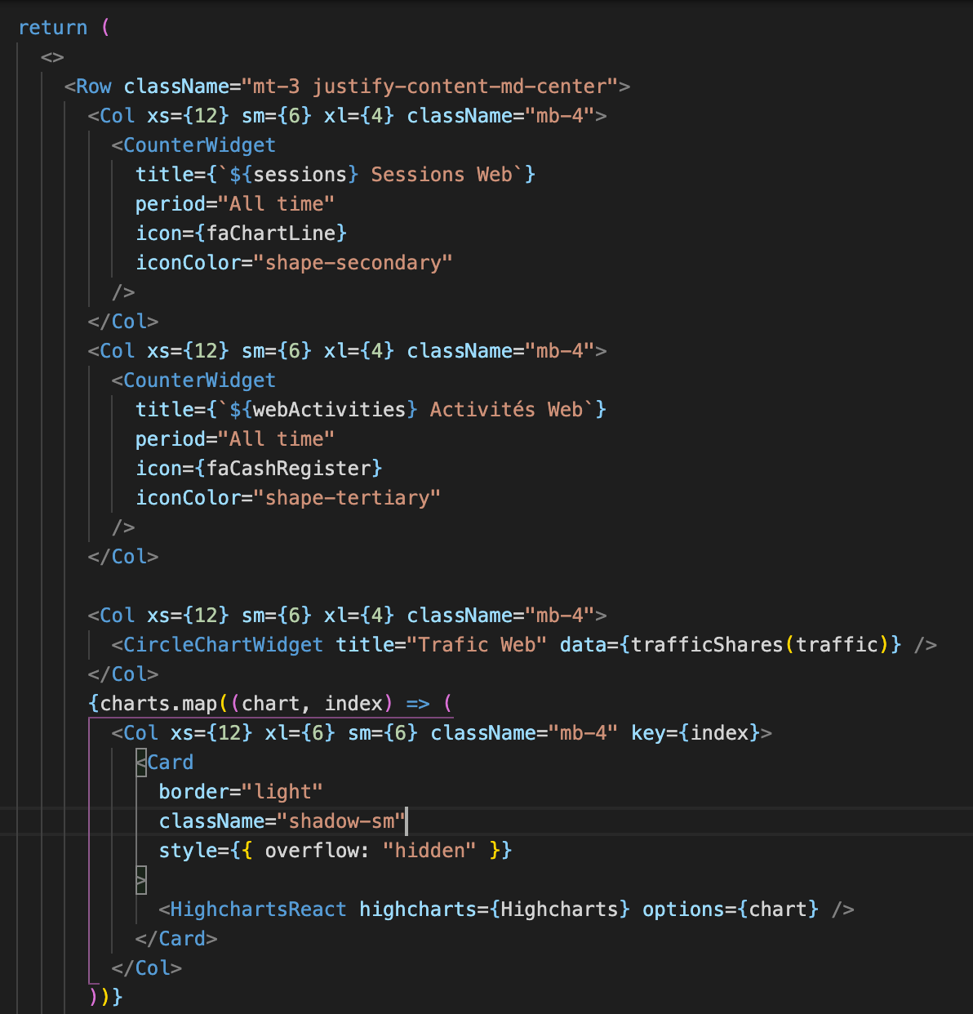
FRONT-END/PAGES
For each Page File:
The render() function is responsible for constructing graphical components on the website, inserting returned data into these components

Slide 6
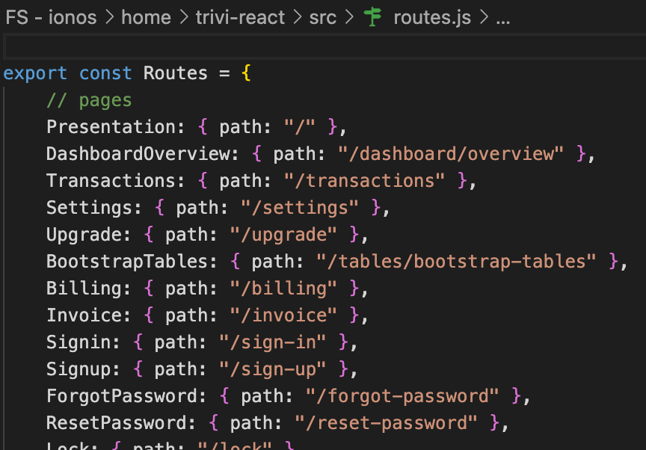
FRONT-END/ROUTERS
File trivi-react/src/routes.js:
Defines all website paths, each path corresponds to 1 page.

Slide 7
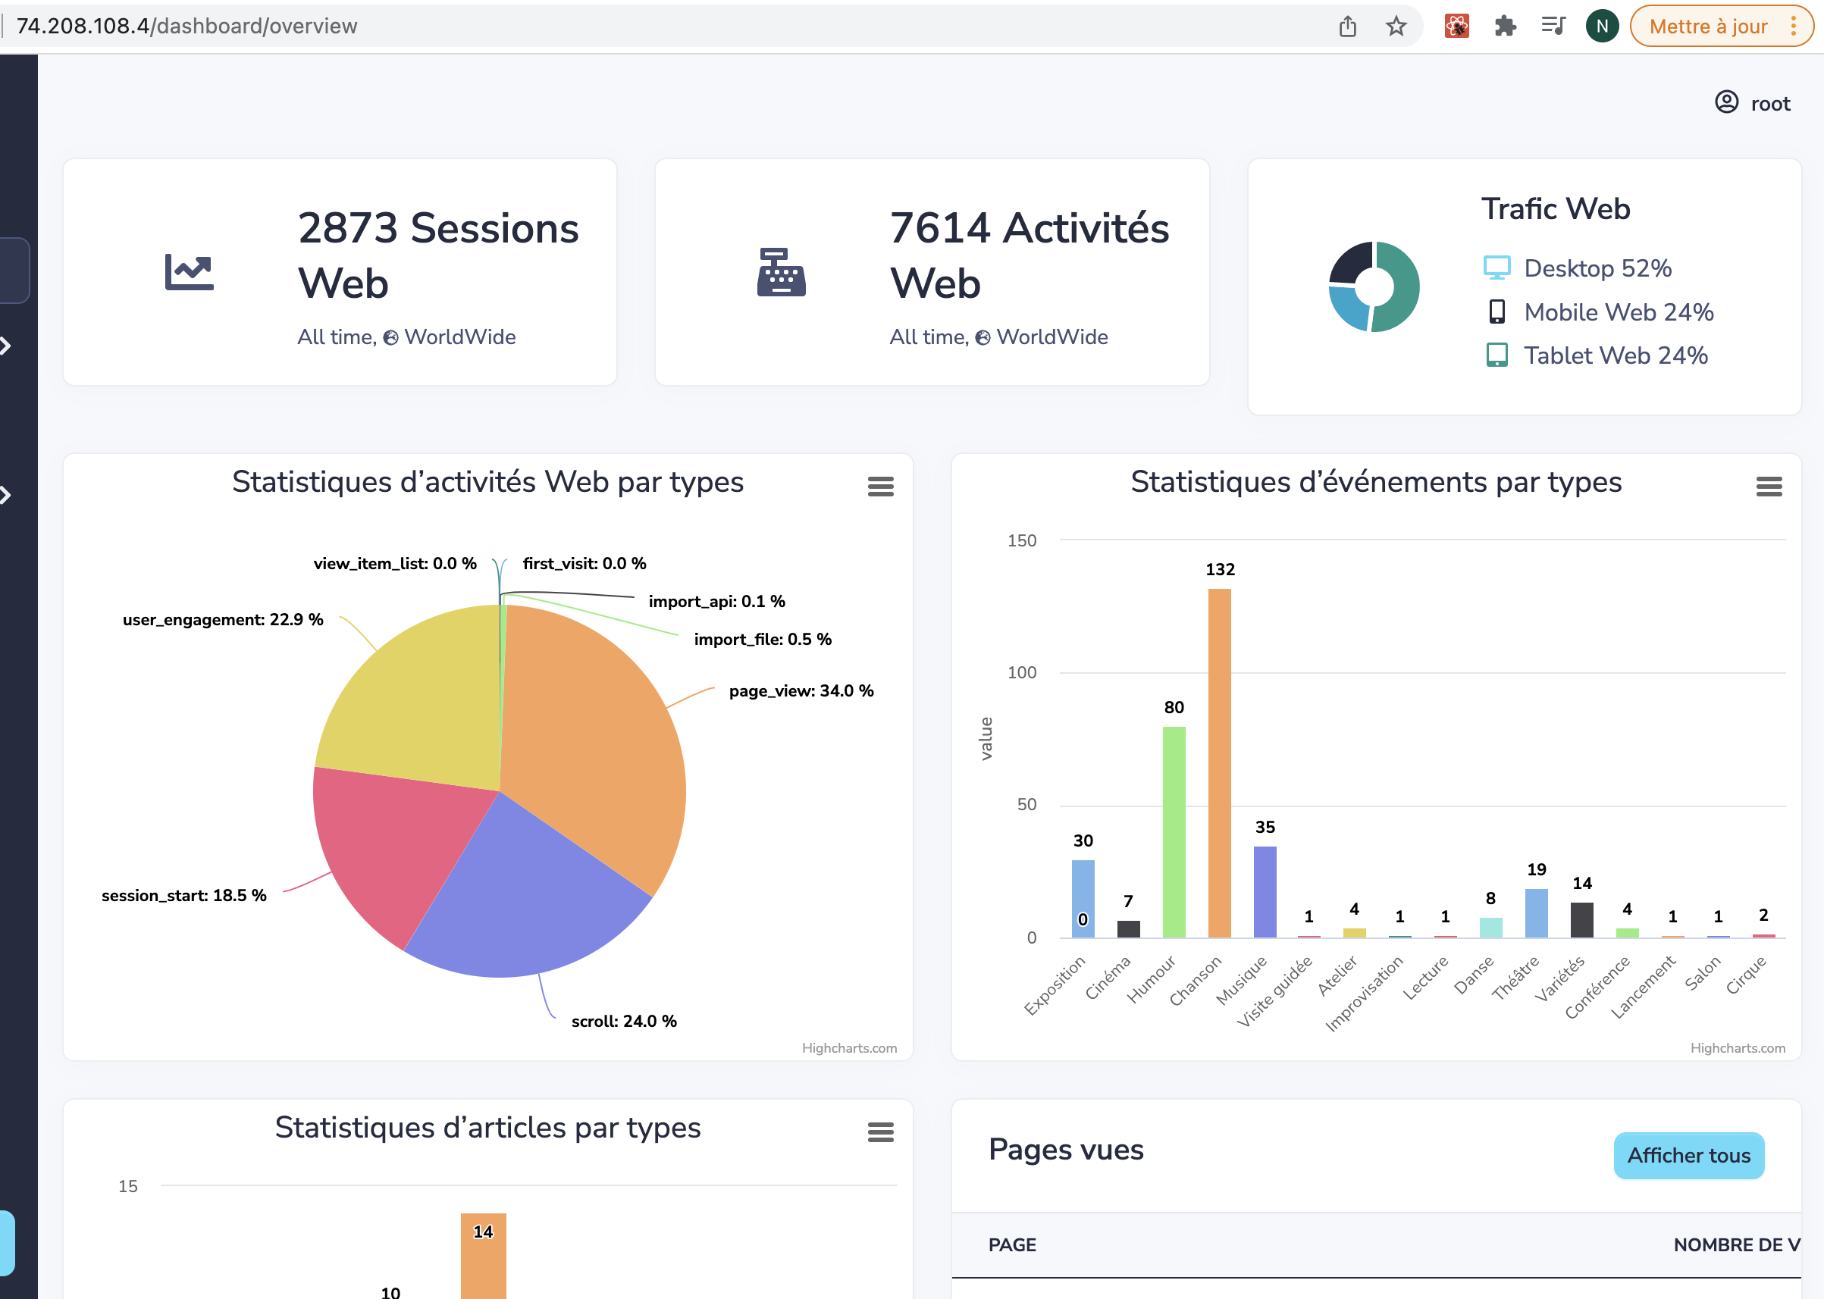
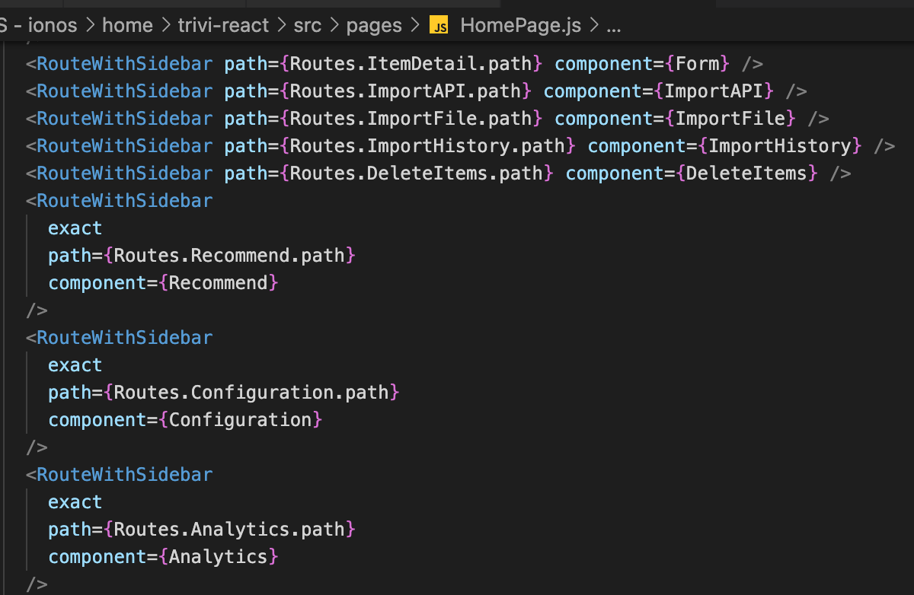
FRONT-END/ROUTERS
File trivi-react/src/pages/HomePage.js:
Map each path on the browser url bar, to the corresponding page

Slide 8
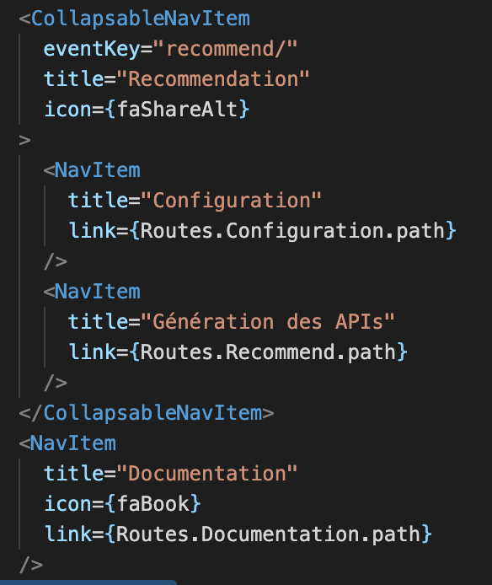
FRONT-END/SIDEBAR
Sidebar shows all functionality buttons.
To add a new functionality button, adjust source code for that button in file “src/components/Sidebars.js”

Slide 9
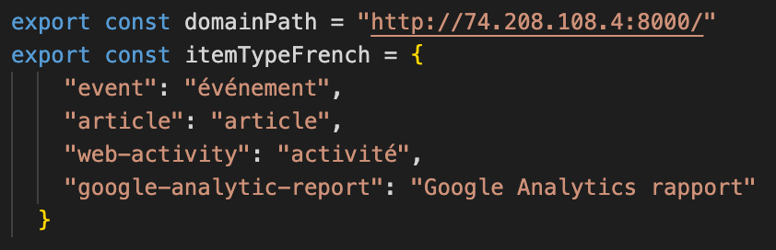
FRONT-END/envIRONMENT VARIABLES
The trivi-react/src/constant/utils.js file contains constant values, configuration information (recommender system IP, etc)

Slide 10
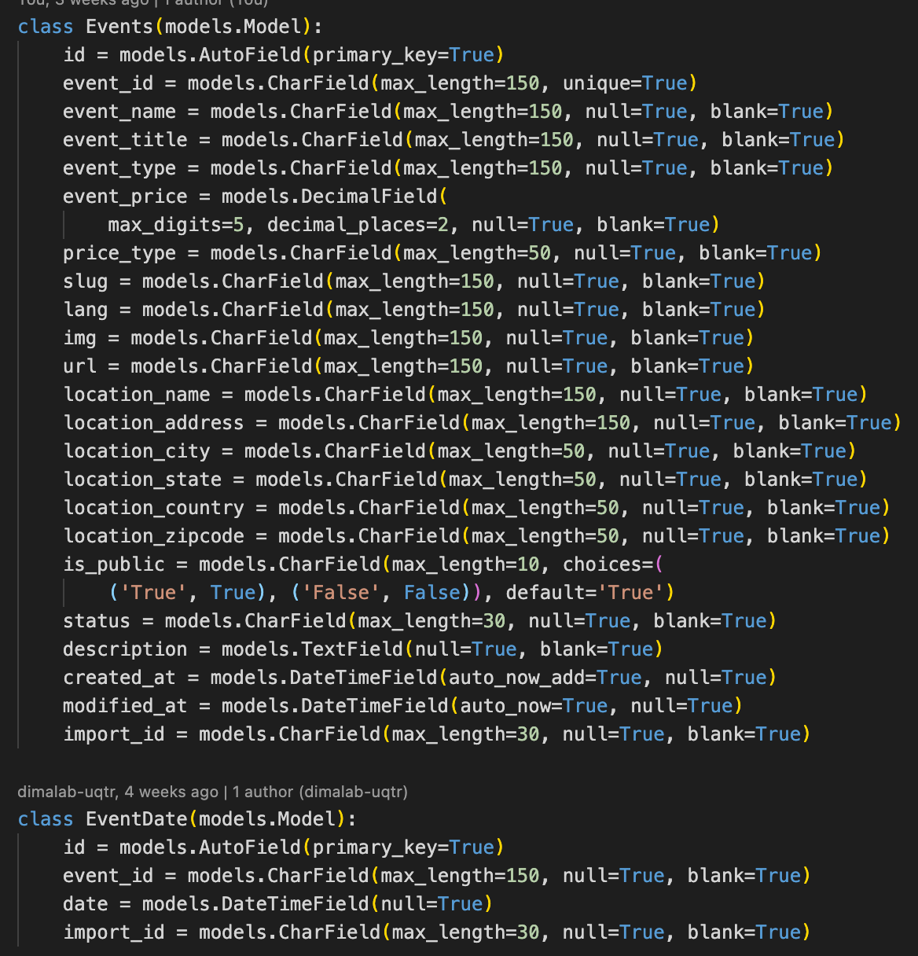
BACK-END/MODELS
The /trivi-backend/recommender/dimadb/ models.py file declares all tables in the recommendation system and their fields.
For example, the system needs to be store data about Events, Products, etc.. Those tables need to be clearly defined their fields, their meta data in this file.

Slide 11
BACK-END/MODELS
When there is a change or new addition of tables and fields, you need to update these new information to the database through the command line
migrate

Slide 12
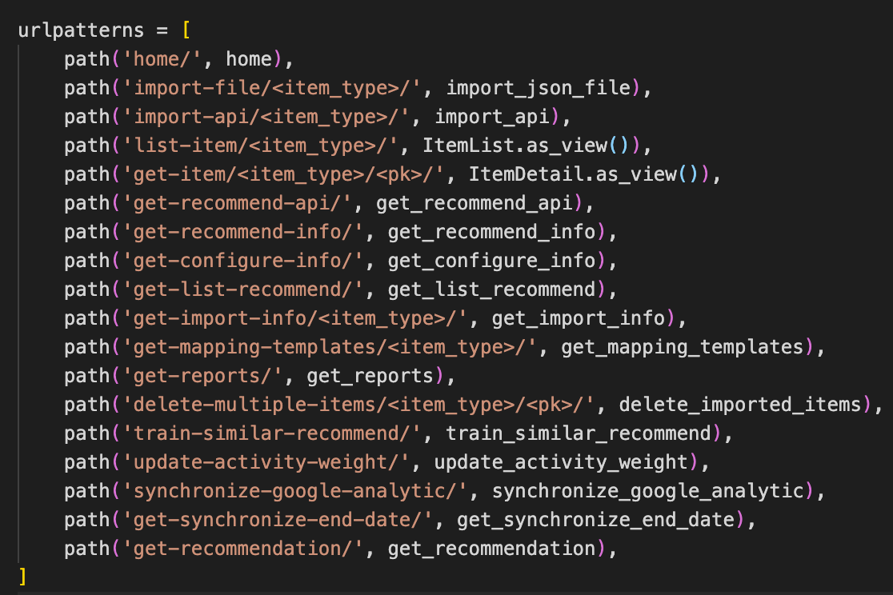
BACK-END/URLS
The /trivi-backend/recommender/dimadb/ urls.py file serves as a request router for the backend system.
Each user request (API) is specified by an URL path. This URL path is then mapped with a logic function (in views.py) to handle (retriving data and responding).

Slide 13
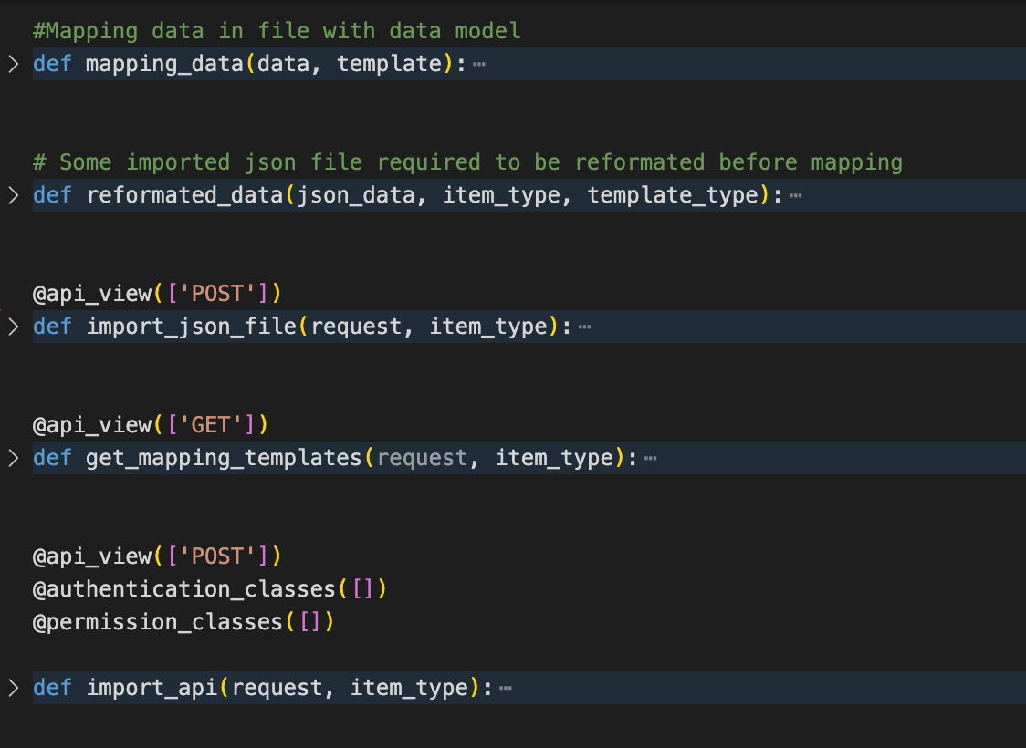
BACK-END/VIEWS
The /trivi-backend/recommender/dimadb/ views.py file contains all logic functions which are responsible for processing system functionalities (data mapping, recommendation), responding user requests.

Slide 14
BACK-END/VIEWS
For view functions mapped with url, we need to define HTTP Method for those functions
@api_view([‘’]), is used to verify HTTP Method:
GET
POST
UPDATE
DELETE

Slide 15
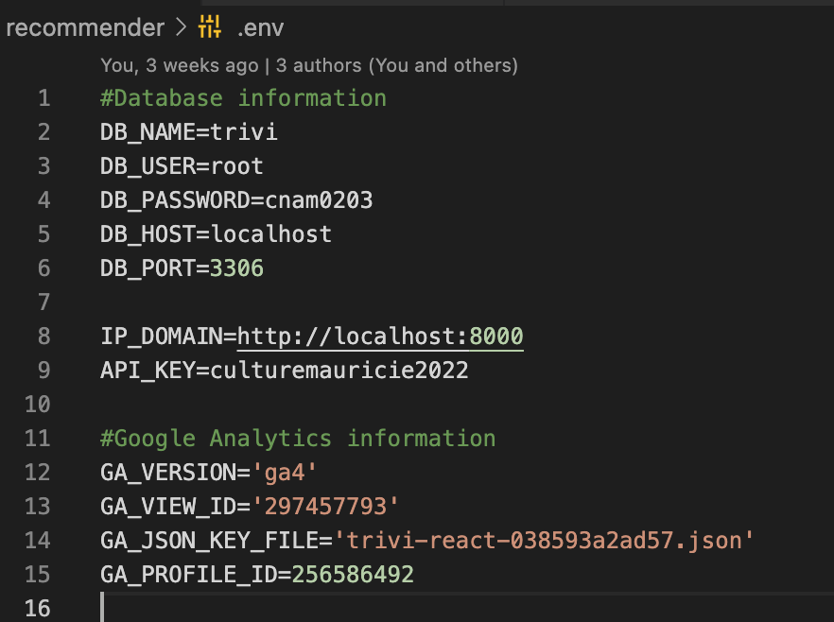
BACK-END/ENVIRONMENT VARIABLES
The trivi-backend/recommender/recommender/.env file contains environment variables, such as database information, ip address of the host machine, api key used for request authentication

Slide 16
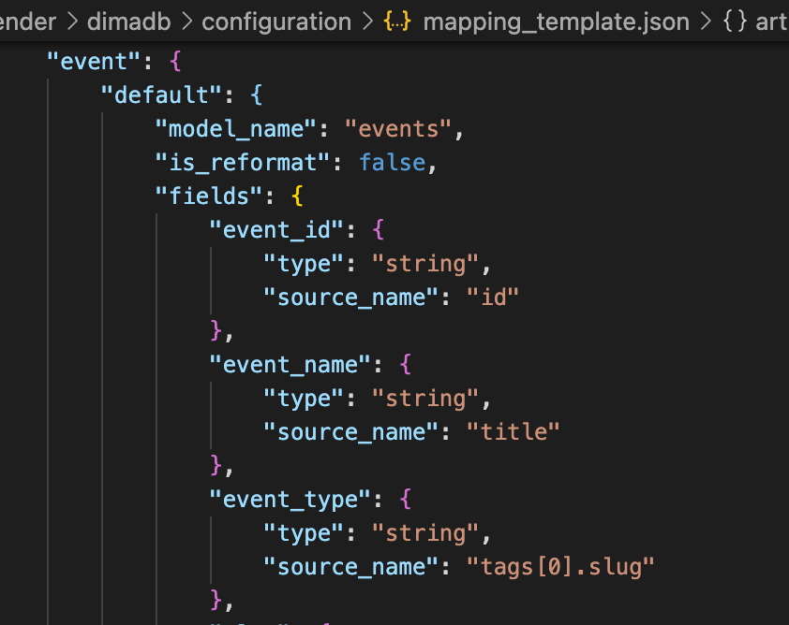
BACK-END/MAPPING TEMPLATES
The trivi-react/src/ configuration/mapping_template.json file defines data structure mapping templates between database tables and imported data sources.

Slide 17
BACK-END/MAPPING TEMPLATES
The trivi-react/src/ configuration/mapping_template.json file defines data structure mapping templates between database tables and imported data sources.

Slide 18
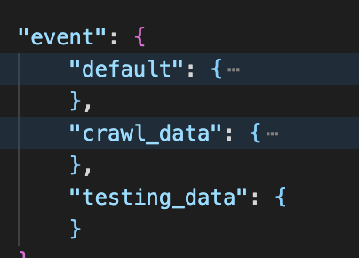
BACK-END/MAPPING TEMPLATES
With the same table, the data in that table can come from many different data sources.
This mapping template file allows to define separate mapping template for each data source

Slide 19
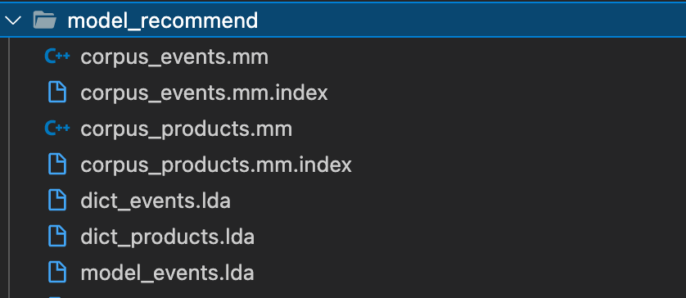
BACK-END/RECOMMEND MODELS
The folder “/trivi-backend/recommender/dimadb/ model_recommend/” contains source codes for machine learning modules (each file in this folder could contain several machine learning modules related to a specified functionality, such as finding item similarities, etc.).

Slide 20
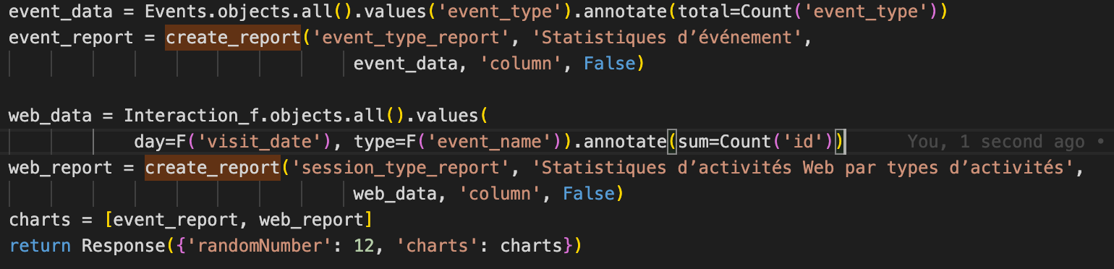
BACK-END/EXAMPLE OF CHARTS

Slide 21
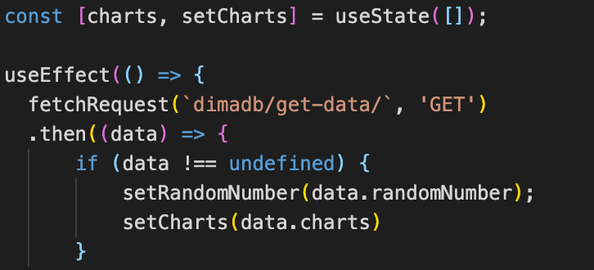
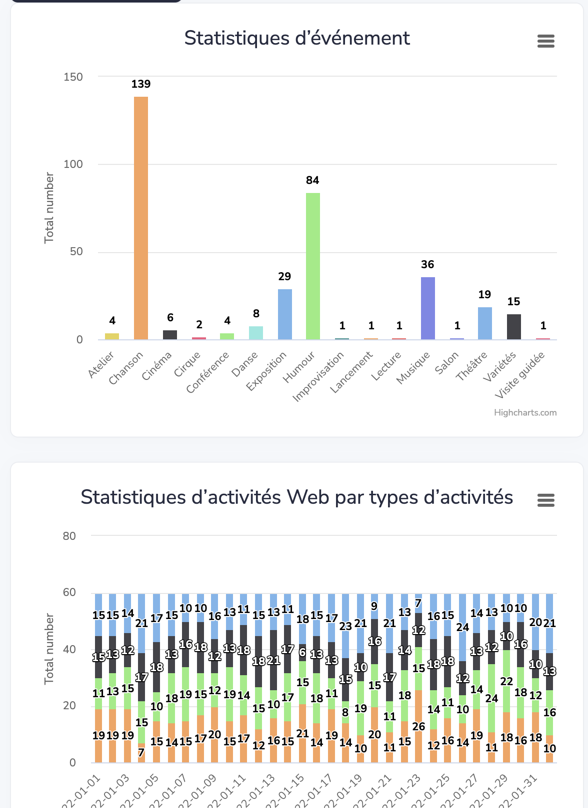
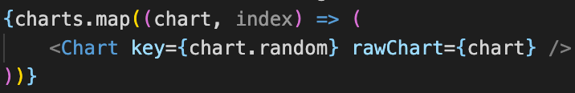
BACK-END/EXAMPLE OF CHARTS

Slide 22
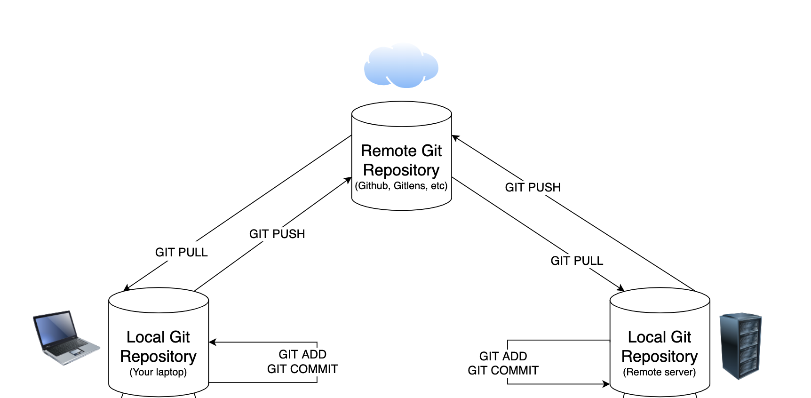
DEPLOYMENT

Slide 23
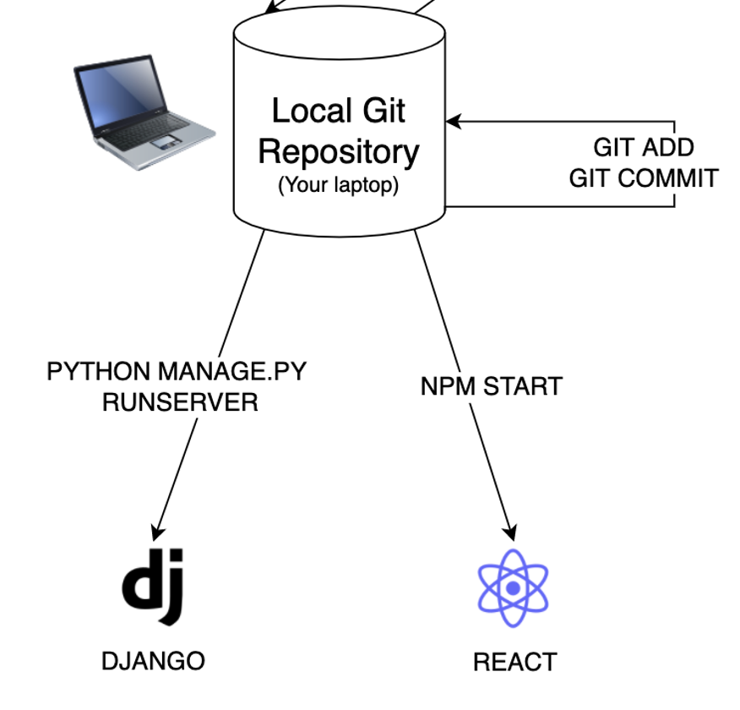
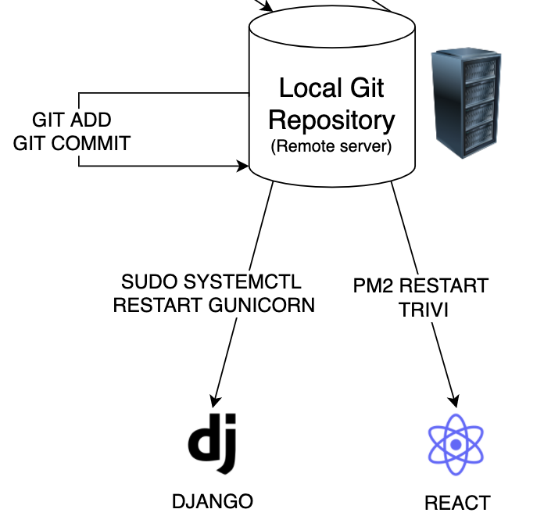
DEPLOYMENT

Slide 24
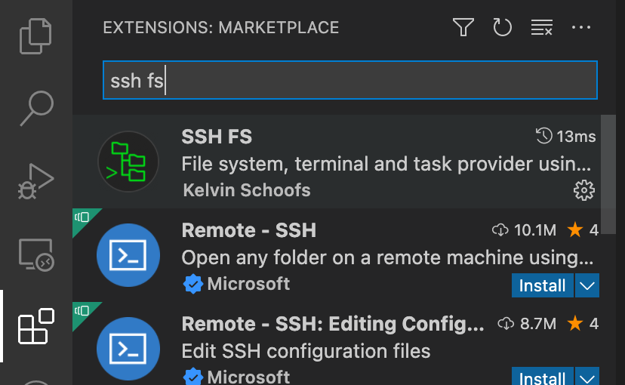
DEPLOYMENT – CONNECT TO remote SERVER
Open Visual Code
Choose extension icon in the sidebar
Search SSH FS (ssh filesystems)
Install SSH FS

Slide 25
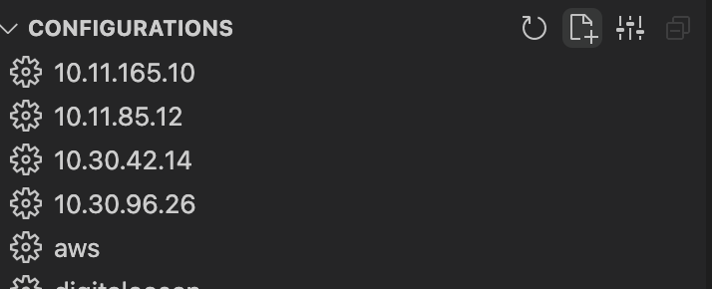
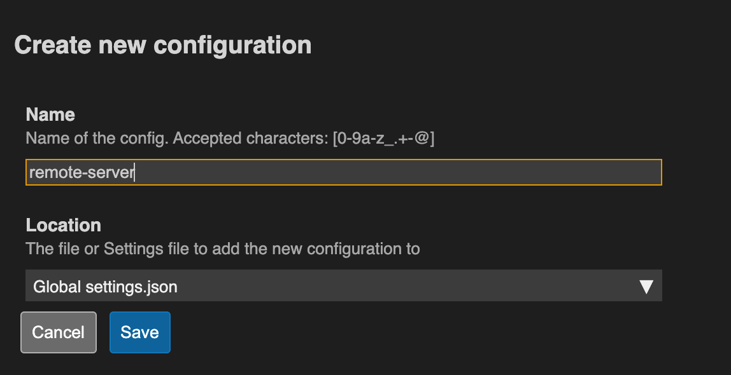
DEPLOYMENT – CONNECT TO remote SERVER
Click SSH FS icon in the Sidebar
Click Add configuration icon

Slide 26
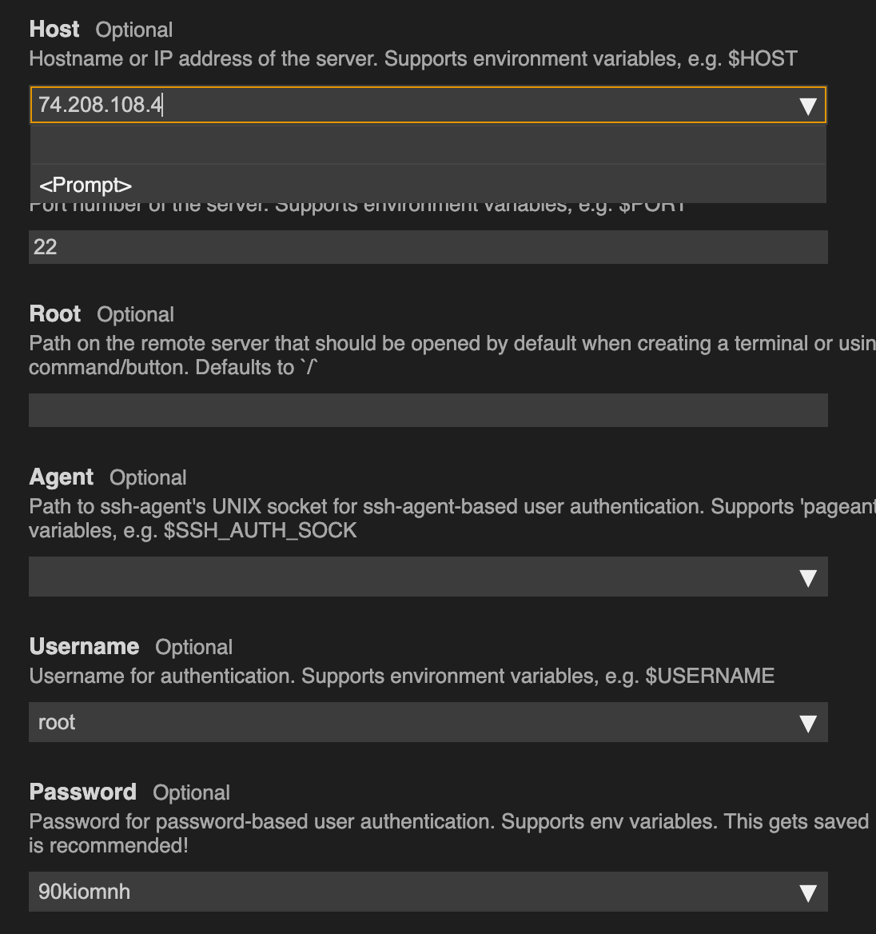
DEPLOYMENT – CONNECT TO remote sERVER
Input Host, Username and Password
Then Save

Slide 27
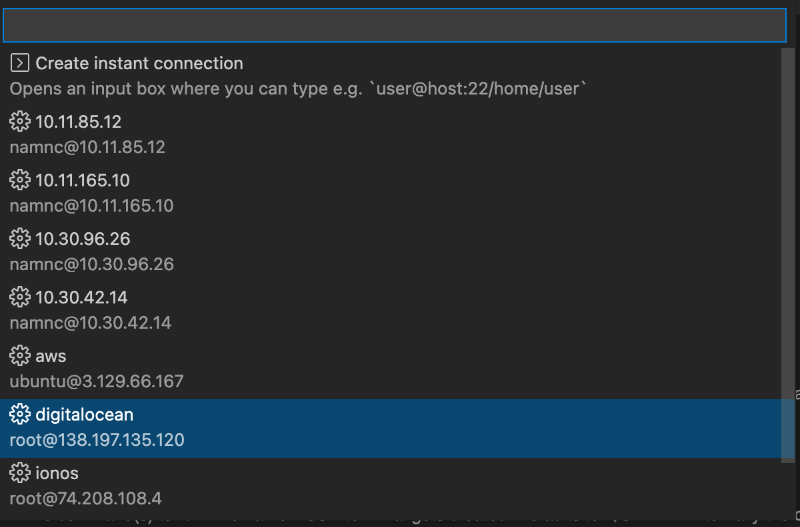
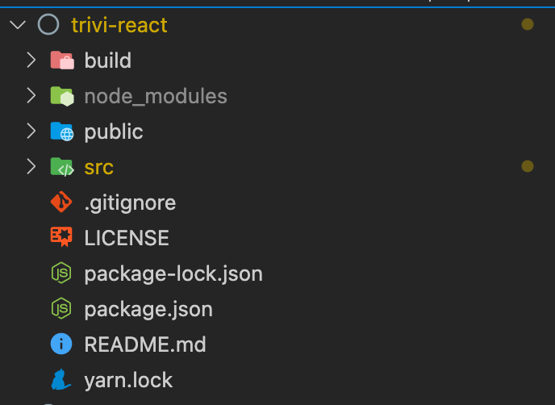
DEPLOYMENT – CONNECT TO remote SERVER
Press CMD + Shift + P
Search SSH FS (Filesystem) -> Enter -> Choose just created instant.
All files in remote server will display in the Sidebar

Slide 28
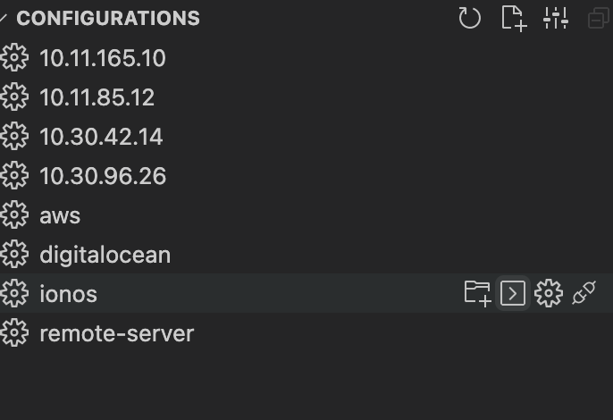
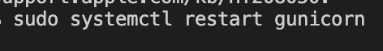
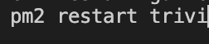
DEPLOYMENT – CONNECT TO remote SERVER
After updating files on the remote server, we must restart backend/frontend
To restart:
Click SSH FS Icon in the Sidebar.
Choose command line icon on the instant server.
A command line would display, type restart command line.
For backend, sudo systemctl restart gunicorn
For frontend, pm restart trivi

